Slide 1
Dr. Neeraj Kumar Pandey CSE Deptt. DITU neeraj.pandey@dituniversity.edu.in
Literals , Variables and Data Types in C#

Slide 2

INDEX
Introduction.
Keywords in C#.
Identifiers in C#.
Literals in C#.
Punctuators in C#.
Data types in C#.

Slide 3
Introduction
Programming language is designed to manipulate certain kinds of data consisting of numbers, characters and strings and provide useful output known as information to the user.
A task of manipulating data is performed by executing a sequence of instructions constituting what is known as a program.
These instructions are formed using certain symbols and words according to some rigid rules known as syntax rules.
C# program is a collection of tokens, comments and white spaces . C# includes the following five types of tokens:
1. Keywords 2. Identifiers 3.Literals 4.Operators 5.Punctuators.

Slide 4
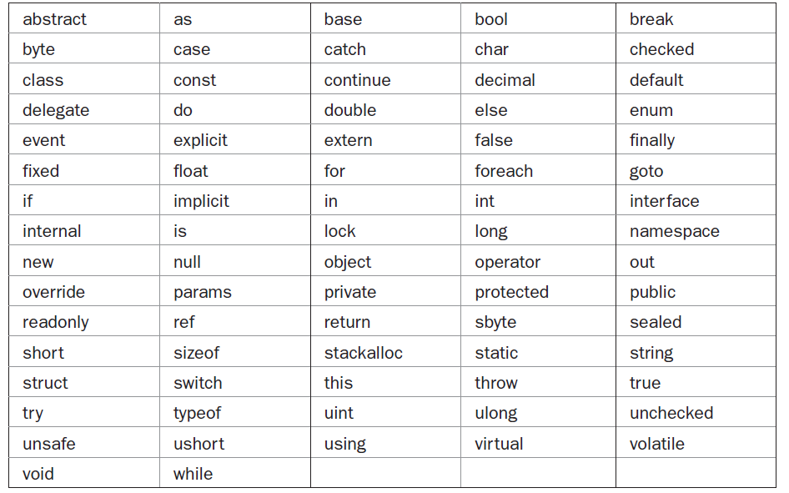
Keywords in C#
1) Keywords are the essential parts of a language definition.
2) They implement specific features of the language.
3) They are reserved and can not be used as identifiers except when they are prefaced by the @ character.

Slide 5
Identifiers in C#
In C#, an identifier is a name assigned to a method, a variable, or any other user-defined
item.
Identifiers can be one or more characters long. Variable names may start with any
letter of the alphabet or an underscore.
Identifiers containing two consecutive underscores, such as max_ _value, are reserved for use by the compiler.
Uppercase and lowercase are different; that is, to C#, myvar and MyVar are separate names.
// Demonstrate an @ identifier.
using System;
class IdTest {
static void Main() {
int @if; // use if as an identifier
for(@if = 0; @if < 10; @if++)
Console.WriteLine("@if is " + @if);
}
}

Slide 6
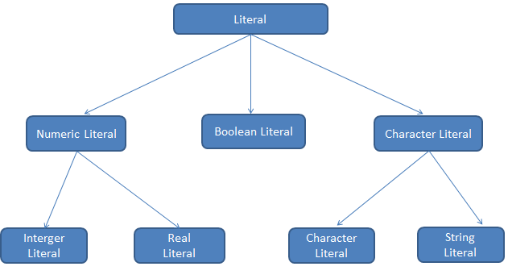
Literals in C#
These are value constants assigned to variables (or result of expression) in a program.
Ex. True,false
Ex. 121,-67,0,65432
Ex. 0.0087, -0.75, 453.67
Ex. ‘5’ , ‘c’, ‘;’
“Hello C#” , “2001”, “?....”
Backslash character literal: ‘\a’ alert , ‘\b’ back space, ‘\n’ new line , ‘\t’ horizontal tab
‘\v’ vertical tab etc

Slide 7
Punctuator in C#
Punctuators (known as separators)are symbols used in expressions to describe operations involving one or more operands of a program.
Parentheses ( )
Braces { }
Brackets [ ]
Semicolon ;
Colon :
Comma ,
Period .

Slide 8
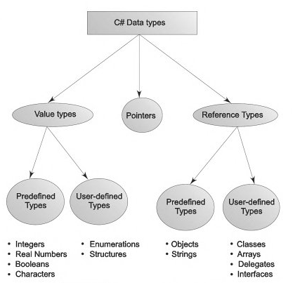
Data Types used in C#
Variable: a variable is an identifier that denotes a storage location used to store a data value
And a variable can change during execution of a program.
Every variable in C# is associated with a data type . Data type specify the size and type of
values that can be stored.
Values types stored in stack. and when value
of one variable assigned to other variable
then the value is actual copied and two copies
of the values are available In memory.
Reference types stored in heap. When
assignment is done then reference is copied
so actual value will be remain same but
two references point to a single value.

Slide 9
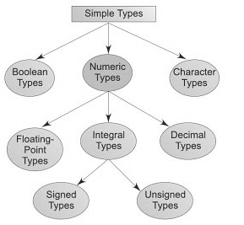
Values Type
Values type of c# is divided in two categories
User defined type (complex type).
Predefined type (primitive or simple type).

Slide 10
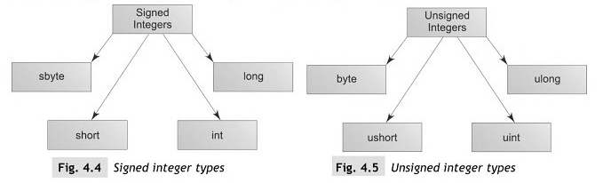
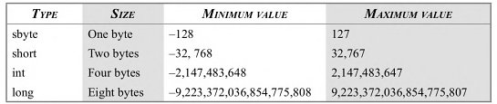
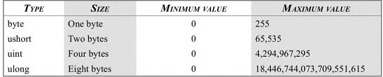
Integral Type
Signed Integer
Wider data types require more time
For execution so try to use data type
According to the requirement.
Unsigned Integer

Slide 11
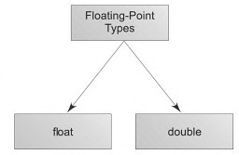

Floating point type
Float type values are single precision numbers with a precision
of 7 bit.
2. Double types represent double precision numbers with 15/16 bits.
Size and range of floating point numbers
Decimal Type: Decimal type is high precision . 128 bit data types that is designed for use in
financial and monetary calculation it can store 1x10⁻²⁸ to 1x10²⁸
Character Type: character type data represented by char and sizes is of two byte to hold single
Character.
Boolean Type: It is used when we want to test a particular condition during the execution of
the program there are only two values that a Boolean type can take : true or false. Boolean type
Can be declare by using keyword bool and uses only one bit of storage.
We can not use zero for false and non zero for true like in C/C++.

